Slide 1
Opportunities for After Your Studies: Identifying Transferable Skills
Chris Fields, PhD
Amel Ghouila, Phd

Slide 2
Overview
What is a transferable skill?
Examples of transferable skills
The academic route
Exercise!
Notes:
This is a talk meant to outline general skills; it’s not focused on comp bio or actually biology in general, but is meant to focus on transferable skills, also known as ‘soft skills’

Slide 3
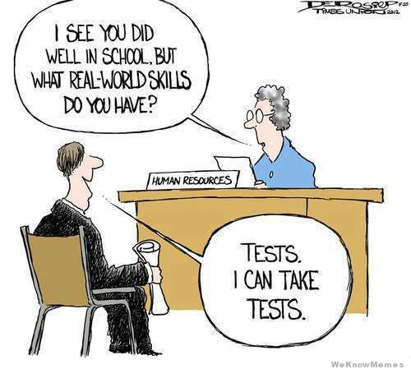
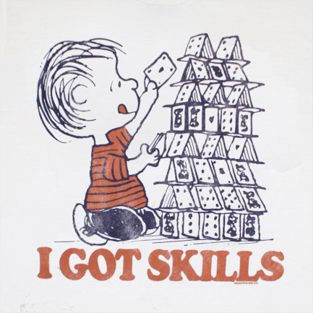
What is a transferable skill?
Skills you have acquired that can be taken with you from job to job
These are skills that increase your ability to land a job you want

Slide 4
Where do you want to go?
Academia?
Industry?
Government?
Law?
Other?
Some skills work best in some career paths, others are more broadly applicable

Slide 5
Examples of transferable skills
People skills
Communication skills
Negotiation skills
Business skills
Creative and strategic thinking
Time management
Motivation and commitment
Personal image and self-awareness
P. Watson, Transferable skills for a competitive edge, Nat Biotechnol. 2003 Feb;21(2):211.

Slide 6
Examples of transferable skills
People skills
Communication skills
Negotiation skills
Business skills
Creative and strategic thinking
Time management
Motivation and commitment
Personal image and self-awareness
P. Watson, Transferable skills for a competitive edge, Nat Biotechnol. 2003 Feb;21(2):211.

Slide 7
People skills
How well do you work with others?
Can you work with difficult people?
You can be both an independent researcher and a team player, they are not mutually exclusive!
P. Watson, Transferable skills for a competitive edge, Nat Biotechnol. 2003 Feb;21(2):211.

Slide 8
Examples of transferable skills
People skills
Communication skills
Negotiation skills
Business skills
Creative and strategic thinking
Time management
Motivation and commitment
Personal image and self-awareness
P. Watson, Transferable skills for a competitive edge, Nat Biotechnol. 2003 Feb;21(2):211.

Slide 9
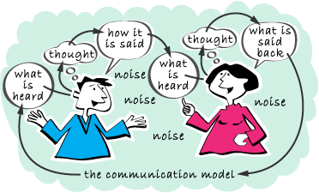
Communication skills
How well do you communicate your research and ideas?
Do you listen to others?
P. Watson, Transferable skills for a competitive edge, Nat Biotechnol. 2003 Feb;21(2):211.

Slide 10
Examples of transferable skills
People skills
Communication skills
Negotiation skills
Business skills
Creative and strategic thinking
Time management
Motivation and commitment
Personal image and self-awareness
P. Watson, Transferable skills for a competitive edge, Nat Biotechnol. 2003 Feb;21(2):211.

Slide 11
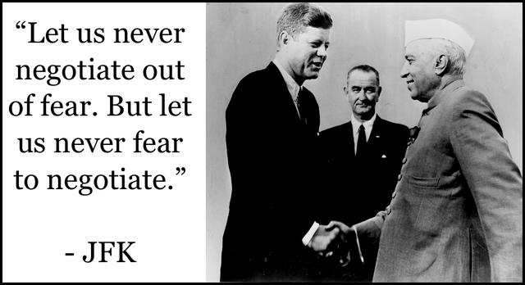
Negotiation skills
Can you ‘strike a deal’?
Are you considered ‘diplomatic’?
Can you negotiate agreements?
P. Watson, Transferable skills for a competitive edge, Nat Biotechnol. 2003 Feb;21(2):211.

Slide 12
Examples of transferable skills
People skills
Communication skills
Negotiation skills
Business skills
Creative and strategic thinking
Time management
Motivation and commitment
Personal image and self-awareness
P. Watson, Transferable skills for a competitive edge, Nat Biotechnol. 2003 Feb;21(2):211.

Slide 13
Business skills
Can you deal with a budget?
Are you able to adequately estimate time for work (and thus costs)?
P. Watson, Transferable skills for a competitive edge, Nat Biotechnol. 2003 Feb;21(2):211.

Slide 14
Examples of transferable skills
People skills
Communication skills
Negotiation skills
Business skills
Creative and strategic thinking
Time management
Motivation and commitment
Personal image and self-awareness
P. Watson, Transferable skills for a competitive edge, Nat Biotechnol. 2003 Feb;21(2):211.

Slide 15
Creative and strategic thinking
Are you a ‘problem solver’?
Can you resolve issues in an expedient manner?
How have you tackled a complex problem before?
P. Watson, Transferable skills for a competitive edge, Nat Biotechnol. 2003 Feb;21(2):211.

Slide 16
Examples of transferable skills
People skills
Communication skills
Negotiation skills
Business skills
Creative and strategic thinking
Time management
Motivation and commitment
Personal image and self-awareness
P. Watson, Transferable skills for a competitive edge, Nat Biotechnol. 2003 Feb;21(2):211.

Slide 17
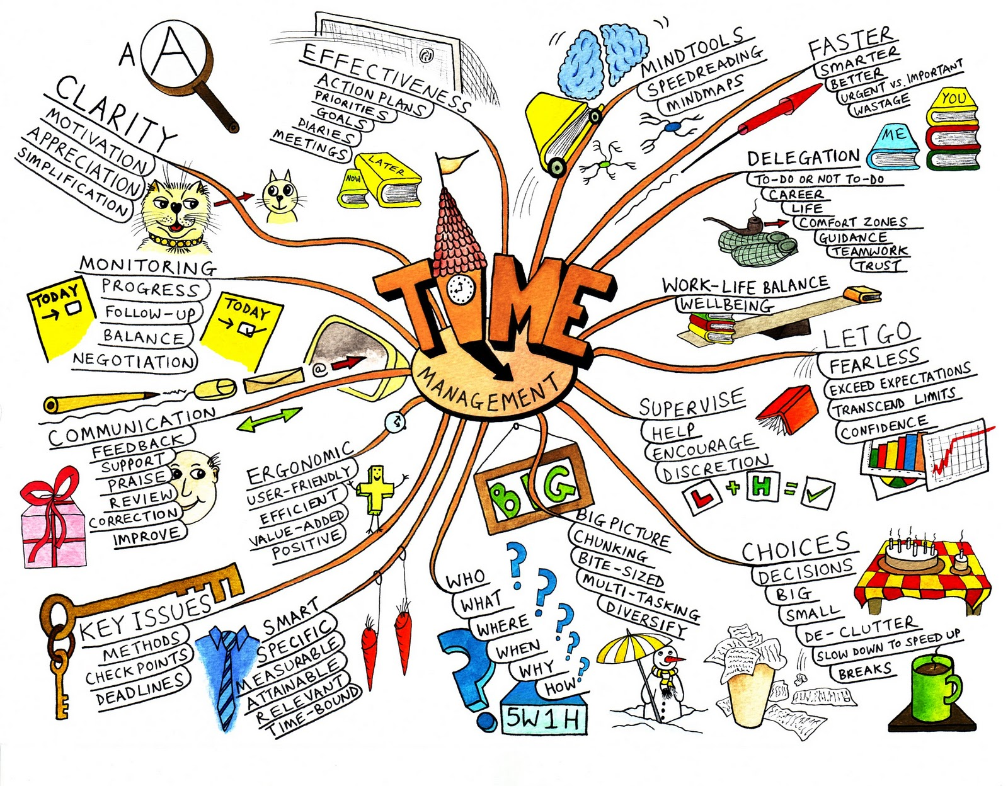
Time management
Are you able to juggle multiple tasks well?
Can you do so based on time and salary commitments?
P. Watson, Transferable skills for a competitive edge, Nat Biotechnol. 2003 Feb;21(2):211.

Slide 18
Examples of transferable skills
People skills
Communication skills
Negotiation skills
Business skills
Creative and strategic thinking
Time management
Motivation and commitment
Personal image and self-awareness
P. Watson, Transferable skills for a competitive edge, Nat Biotechnol. 2003 Feb;21(2):211.

Slide 19
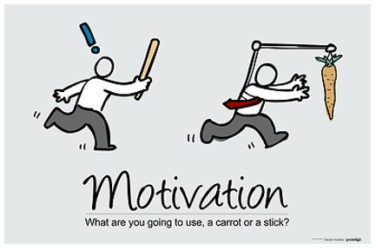
Motivation and commitment
Do you show enthusiasm for your career choice?
Are you able to commit the time and resources to get the job done?
Can you bring out these qualities in others?
Leadership skills!
P. Watson, Transferable skills for a competitive edge, Nat Biotechnol. 2003 Feb;21(2):211.

Slide 20
Examples of transferable skills
People skills
Communication skills
Negotiation skills
Business skills
Creative and strategic thinking
Time management
Motivation and commitment
Personal image and self-awareness
P. Watson, Transferable skills for a competitive edge, Nat Biotechnol. 2003 Feb;21(2):211.

Slide 21
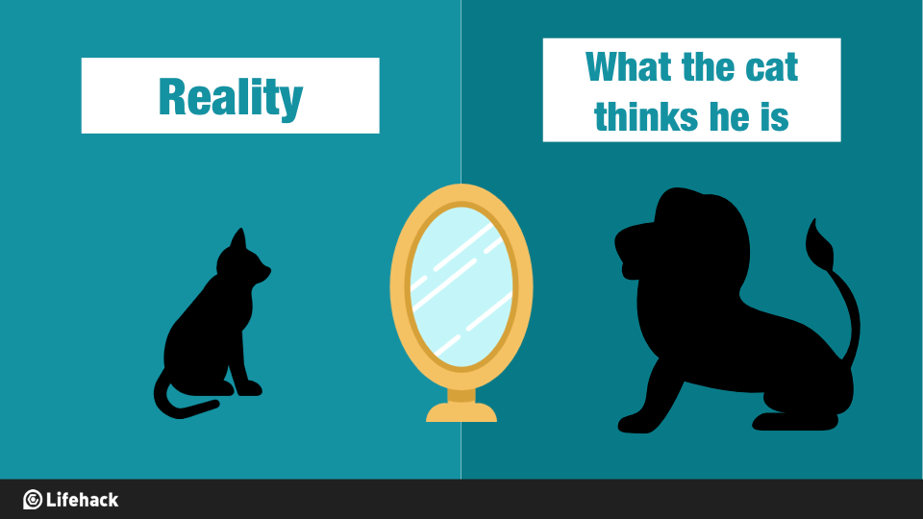
Personal image and self-awareness
Does your appearance convey to others that you can do the job?
Do you have the confidence to take up a new challenge?
P. Watson, Transferable skills for a competitive edge, Nat Biotechnol. 2003 Feb;21(2):211.

Slide 22
The Academic Route
A few additional items to consider if you are interested in going into academia
Not all of these are actually transferable skills…
but are definitely points worth keeping in mind if intend on pursuing an academic career
T. Lappalainen, From trainee to tenure-track: ten tips, Genome Biology (2015) 16:132

Slide 23
The Academic Route
Work hard
Have fun
Do good work (and get it done)
Network!
Choose your area of expertise
Join a great lab
Build a diverse skill set
HAVE A LIFE!
Challenge yourself
Be brave, persistent, and patient
T. Lappalainen, From trainee to tenure-track: ten tips, Genome Biology (2015) 16:132

Slide 24
A few more papers of interest
Biology needs more staff scientists (Nature)
Ten simple rules in considering a career in academia versus government (Phil Bourne – PLOS CompBio)

Slide 25
Questions?

Slide 26
Exercise Identify Transferable Skills
Worksheet

